Slide 1
Kandis Lamke
Ruben Garcia
April 3, 2020

Slide 2




Agenda
Introductions
Executive Summary
Industry Overview
Topic chosen
Key Objectives
Used technologies & Method
R programming
Python
Project Results
Analysis
Key findings
Conclusions
Next steps
Q&A
Notes:
Outline Agenda

Slide 3
Professional profile
Professional Experience
Chief Operating Officer
Controller
Accounting Manager
Entrepreneur
Education
Bachelor of Arts – Accounting Major
Licensed CPA
Kandis
Lamke

Slide 4
Professional profile
Professional Experience
OpEx programs implementation across Global Operations
Lean transformation throughout the Supply Chain
Centers of Excellence implementation
Lead Supplier Development programs
Education
MBA – Global Management
BS – Industrial Engineering
Lean Six Sigma Black Belt
Certified OCM professional
Certified SCM professional
Ruben
Garcia

Slide 5



Project introduction and Background

Slide 6


Industry:
PEO - Professional Employer Organization
Definitions:
WSE – Worksite Employee. Employees under the co-employment agreement that are supported by the payroll and human resources functions of the PEO.
Internal EE – Internal employees of the PEO that support clients and employees under the co-employment agreement.
Notes:
Project Summary – Domain Knowledge and Insight into the PEO Industry and standard benchmarks, etc

Slide 7
PEO overview
PEOs provide access to cost-effective training and development
50% of business using PEOs are less likely to fail
30% time relieved by SMB leadership due to administrative and transactional issues
68% PEOs saw somewhat or significant revenue increase
35% PEOs saw a significant increase in WS_EE per client
56% PEOs saw somewhat or significant gross profit increase
28% PEOs saw somewhat or significant INT_EE (including Sales) increase
48% PEOs saw somewhat or significant Clients increase
85% PEOs see somewhat or significant WSEs change over the next 12 months
Notes:
Languages and methods used in the analysis

Slide 8
Project Methods
Notes:
Languages and methods used in the analysis

Slide 9
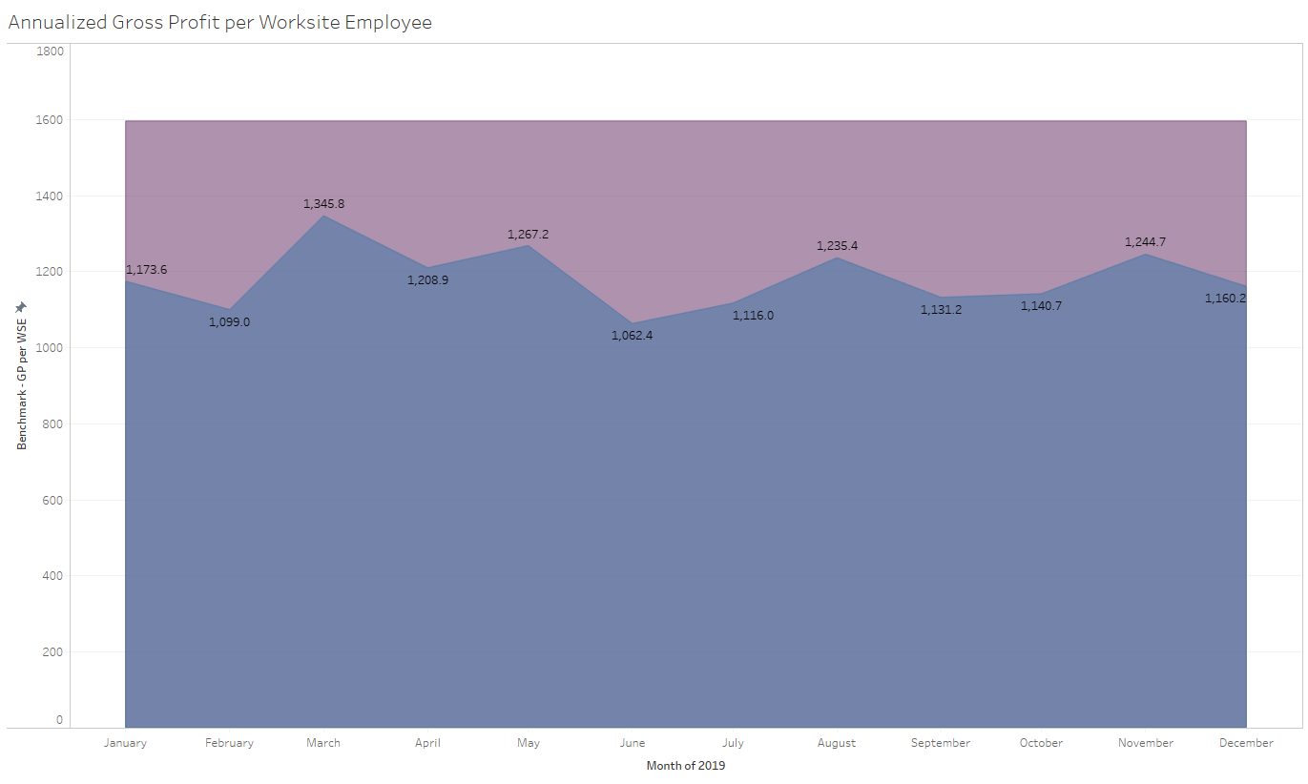
Project results

Slide 10

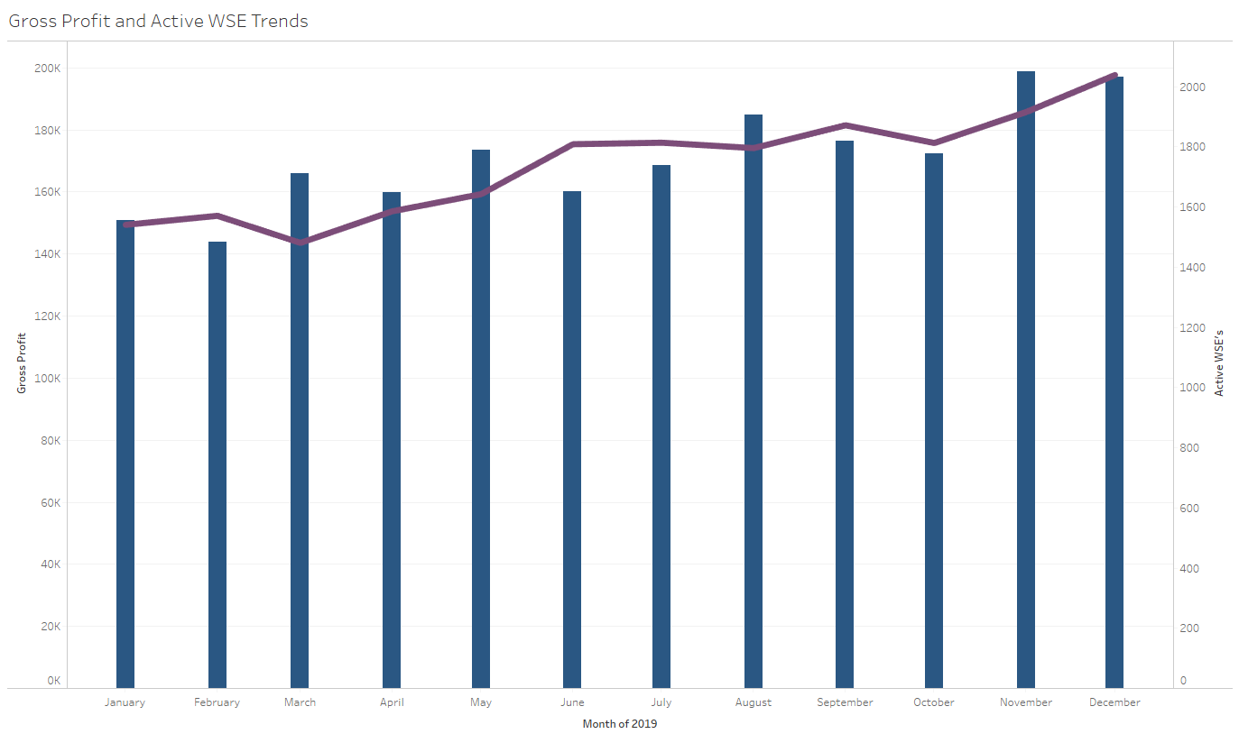
Project results

Slide 11
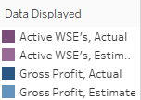
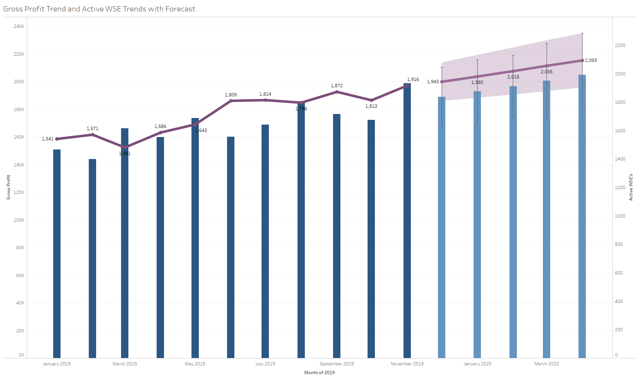
Project results

Slide 12

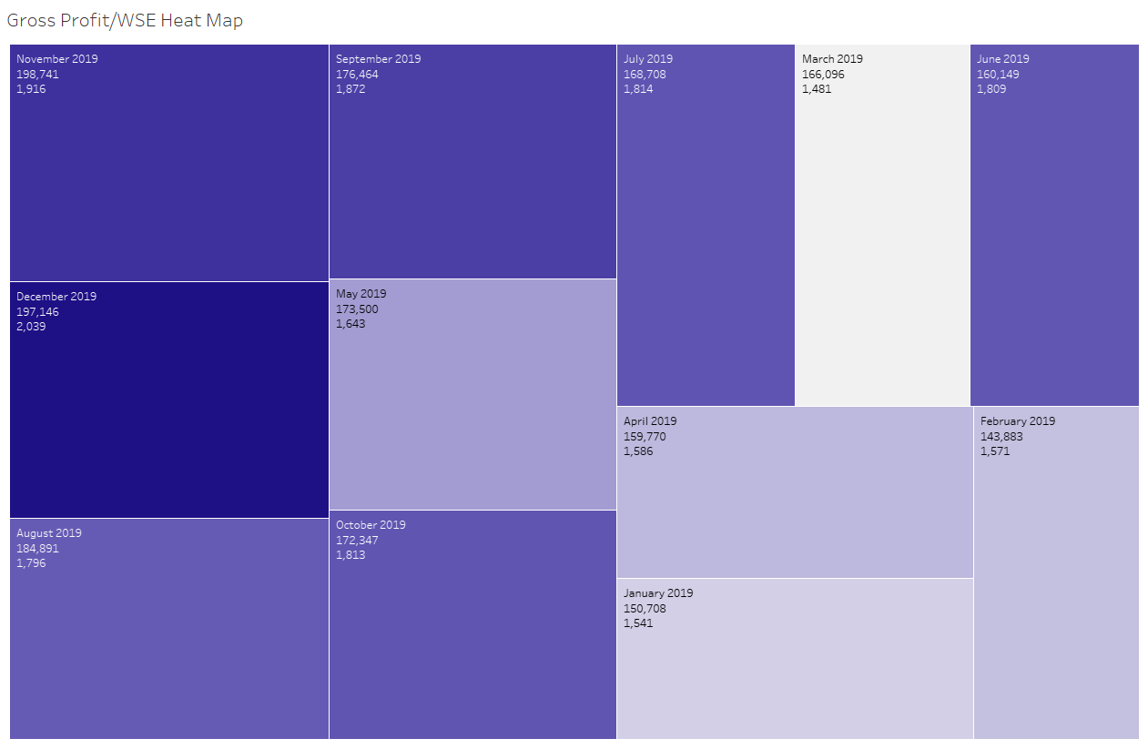
Project results

Slide 13
Project introduction and Background

Slide 14
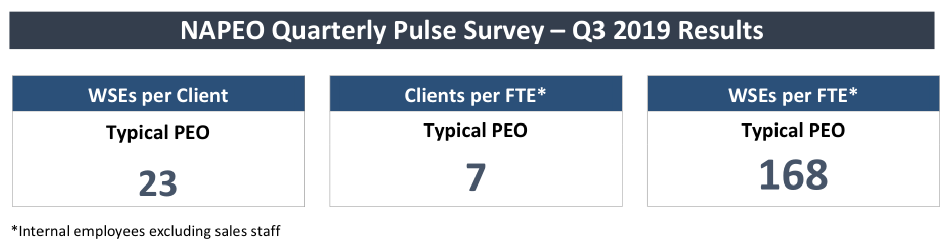
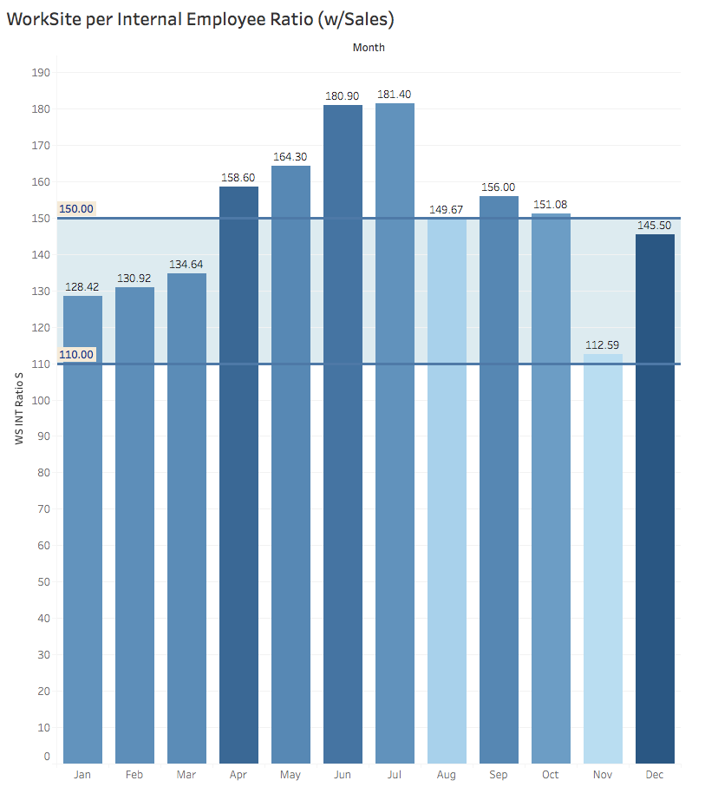
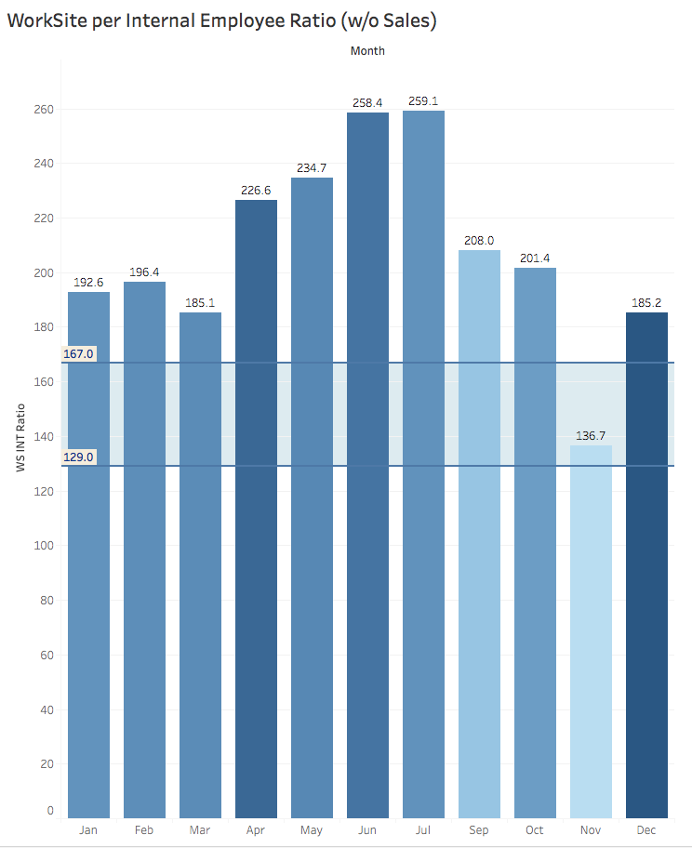
Project results

Slide 15
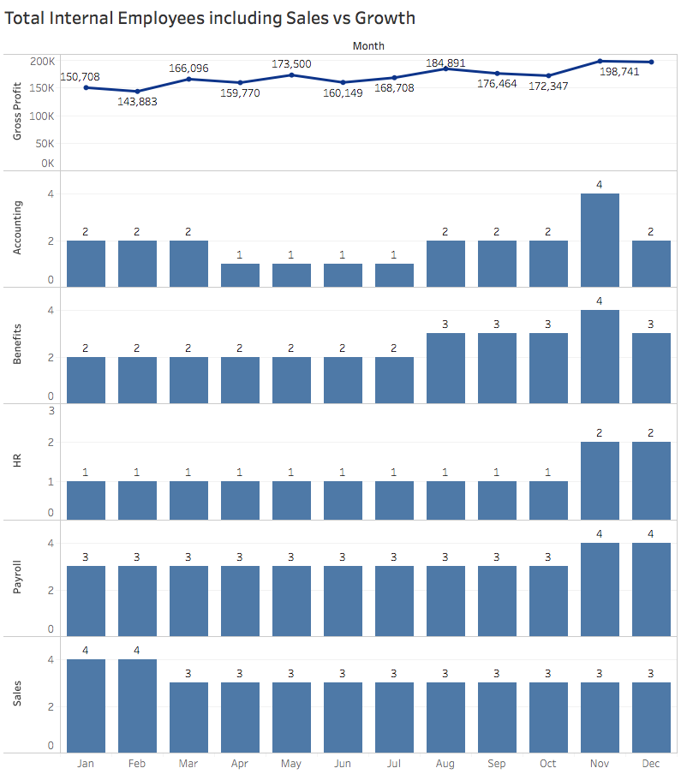
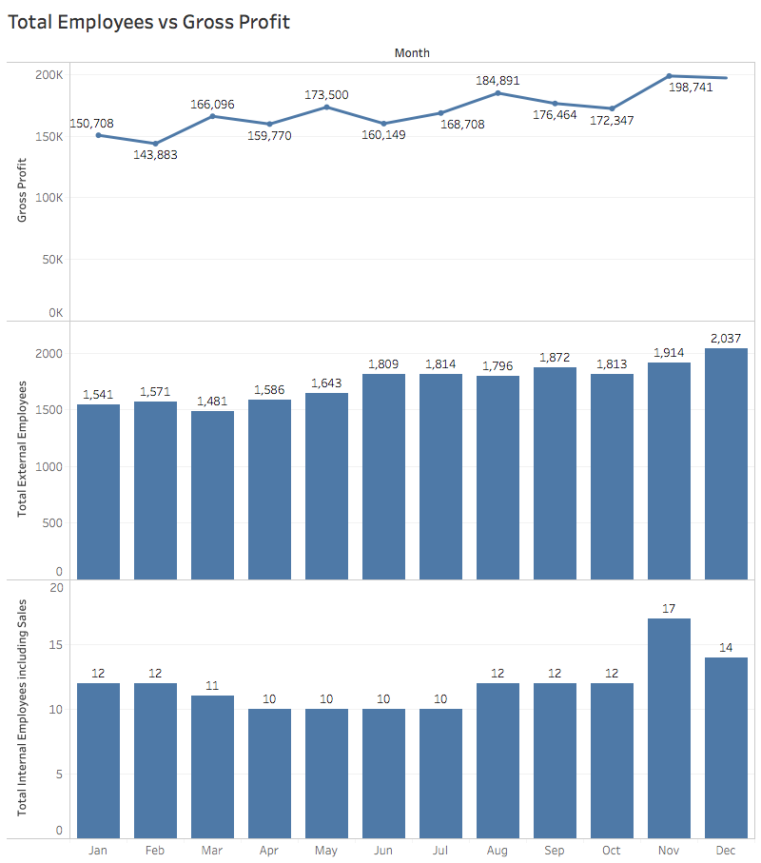
Project results

Slide 16
Project results

Slide 17
Project results

Slide 18
summary

Slide 19
Conclusions

Slide 20
next steps

Slide 21
QUESTIONS?

Slide 22
